Slide 1
Professional Development
for teachers of English Language Learners
Notes:
Here is a note to see what it would look like when we print.

Slide 2
Introduction
who we are and what we do

Slide 3
Willard ESL team
Ms. Lynne Sauer – ESOL endorsed teacher for Willard High School, Willard Middle School, East Elementary, and Central Elementary.
Ms. Emily Teal - ESL paraprofessional for Willard Middle School, East Elementary, and Central Elementary.
Mrs. Susan Bray - ESOL endorsed teacher for Willard Intermediate School, South Elementary, and Orchard Hills Elementary.
Mrs. Krista Masters - ESL paraprofessional for Willard Intermediate School, South Elementary, and Orchard Hills Elementary.
Notes:
Our English as a Second Language (ESL) team consists of 4 staff members: 2 ESOL (English to Speakers of Other Languages) endorsed teachers, and 2 highly qualified paraprofessionals. We service a total of 120 English Language Learners (ELLs) in the Willard school district from a variety of cultural and linguistic backgrounds.

Slide 4
Department Goals: Annual measurable achievement objectives
AMAO 1 – ELLs are making progress in learning English.
Progress is measured by comparing overall composite proficiency scores on the ACCESS for ELLs assessment from year to year.
AMAO 2 – ELLs are attaining English language proficiency.
English language proficiency is qualified as an overall composite score of 5.0 on the ACCESS for ELLs assessment, with minimum proficiency levels of 4.0 on both the Reading and Writing domains.
AMAO 3 – ELLs are meeting AYP targets for the Limited English Proficient (LEP) subgroup for both English Language Arts (ELA) and Mathematics.
AYP targets for the LEP subgroup are based on the objective of cutting the achievement gap in half between LEP students and the group of total students by the year 2020.
Notes:
Our ESL team has 3 goals that we are held accountable for each year at the state level, called Annual Measurable Achievement Objectives (AMAO’s).
-Our first goal (AMAO 1) is that ELLs are making progress in learning English. Progress is measured by comparing overall composite proficiency scores on the ACCESS for ELLs assessment from year to year. A certain percentage of students from our district have to make progress in order to meet this objective.
-Our second goal (AMAO 2) is that ELLs are attaining English language proficiency. English language proficiency is qualified as an overall composite score of 5.0 on the ACCESS for ELLs assessment, with minimum proficiency levels of 4.0 on both the Reading and Writing domains. A certain percentage of students from our district have to attain English language proficiency in order to meet this objective.
-Our third goal (AMAO 3) is that ELLs are meeting AYP targets for the Limited English Proficient (LEP) subgroup for both English Language Arts (ELA) and Mathematics. AYP targets for the LEP subgroup are based on the objective of cutting the achievement gap in half between LEP students and the group of total students by the year 2020. A certain percentage of students from our district have to meet AYP targets in ELA and Math in order to meet this objective.
For each of the past 4 years, the Willard ESL department has met AMAO 1 and AMAO 2. Students are making progress in learning English, and students are attaining English language proficiency. The past 4 years, we have not met AMAO 3, so we currently have an improvement plan in place to increase the percentage of ELLs who are meeting AYP targets for ELA and Math. Working with you, the classroom teachers, to help make content comprehensible for ELLs is one of the parts of our improvement plan.

Slide 5
ESL program in Willard
identifying, assessing, servicing, transitioning, monitoring, and notifying

Slide 6
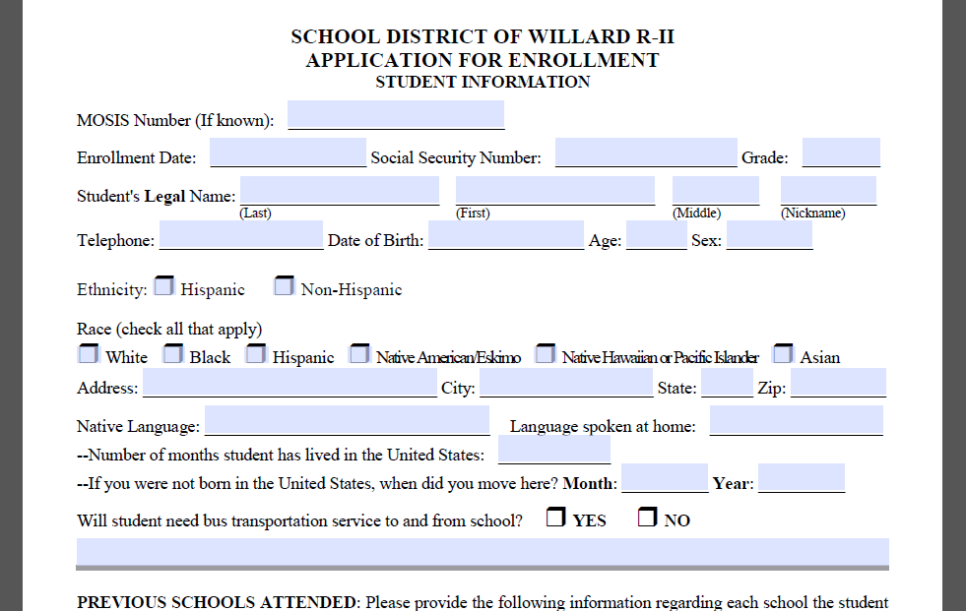
Identifying and assessing students
Counselors and secretaries
look over enrollment forms to
see if a language other than
English was mentioned
An ESL teacher is notified
of any student who has a
second language background.
They administer the WIDA ACCESS Placement Test (WAPT) to determine whether the student is eligible for ESL services.
Notes:
There is a set of questions on each school’s enrollment form that helps us determine if a student might potentially be LEP, immigrant, or migrant. When secretaries and counselors receive enrollment documents, they put aside forms that indicate another language is spoken by the student or spoken in the student’s home and contact their building’s ESL teacher. Some schools also have a Home Language Questionnaire included in their enrollment packet that is used to identify what role a second language has in a student’s home. The ESL teachers review files of new students who may be LEP and determine whether students need to be screened for ESL services.
Sometimes students are not properly identified when they enroll in our district. Maybe a parent failed to mention that another language is spoken in the home on their enrollment form, but you as a classroom teacher notice that a student’s parents speak another language at home. Please let your building’s ESL teacher know if you notice these things so that we can screen the student if necessary and give them proper support. We rely on other staff in our buildings to be our eyes and ears in identifying potential LEP students since we are not there all the time.
Screening potential LEP students
After an ESL teacher has reviewed a student’s file and determined that the student needs to be screened for ESL services, they will administer the WIDA ACCESS Placement Test (WAPT) to the student. This test is divided into grade clusters, and normally includes 4 parts that test a student’s English proficiency in speaking, listening, reading, and writing. (The Kindergarten WAPT only tests proficiency in speaking and listening).

Slide 7
Providing services
Students who qualify with the WAPT are considered LEP and entered into the ESL program.
Elementary and Intermediate School ESL Program
Pull-Out ESL model
Content-Based ESL model (Push-In)
Middle School ESL Program
Sheltered ESL Classroom (English Language Arts Class for ESL Students)
Resource Classroom
High School ESL Program
Resource Classroom
Every student receives an Individual Language Plan (Accommodations Plan) – modifications and accommodations to be successful in the mainstream classroom and strategies for the teacher(s) working with that student.
ESL Services – based on Missouri Recommended Instructional Minutes
Notes:
Students who have qualifying scores on the WAPT are classified as LEP and entered into the ESL program. ESL students at the elementary and intermediate level participate in either a pull-out ESOL model or a content-based (push-in) ESOL model. ESL students at the middle school level participate in either a sheltered ESL classroom (English Language Arts Class for ESL students) or a resource classroom. ESL students at the high school level participate in a resource classroom. Every student is given an Individual Language Plan, or accommodations plan, each school year that they participate in the ESL program. These accommodations are chosen based on student’s proficiency scores to help students be successful in the regular education classroom, and they serve a dual purpose of providing strategies classroom teachers can use with their ESL student in class. A signed copy is kept on file for each student.
The type and amount of services provided to students is based on the Missouri Recommended Instructional Minutes, which starts out at 45 minutes per week for an advanced Kindergarten or 1st grade student and goes up to 600 minutes per week for a beginning 4th-8th grader or beginning or intermediate high school student. Each member of the ESL team creates a schedule to get as close to the recommended instructional minutes as possible.

Slide 8
Transition criteria
ACCESS for ELLs assessment
For any grade level:
Overall Composite Score of 6.0
For grades 4-12:
Overall Composite Score of 5.0 PLUS evidence of academic English language proficiency (at least 2 of the following)
District benchmark examinations
Writing samples or performance assessments with formal, standardized rubrics
State assessments
Academic records such as semester or end-of-course grades
Notes:
Each year, students take the ACCESS for ELLs assessment during the months of January and February. The test measures students’ English proficiency in speaking, listening, reading, and writing. It is a standardized test that we administer and send to be scored. We usually receive students’ scores back in May, and we use these results to plan for the following school year and for data analysis for our program from year to year.
Students remain in the ESL program until they have reached our district’s definition of proficient. For students in all grades, an overall proficiency score of 6.0 is an automatic reclassification from LEP to Monitor Year 1. For students in grades 4th-12th, an overall proficiency score of 5.0 or above is required, plus evidence of academic English language proficiency - which can come from district benchmark examinations, writing samples or performance assessments with formal, standardized rubrics, state assessments, and academic records such as semester or end-of-course grades – and parent agreement that the student has reached full English proficiency.

Slide 9
Monitoring students
After “Transition” from ESL – student is monitored for 2 years
Two years of monitoring called MY1 and MY2
During MY1 and MY2, student will not receive ESL services or classroom accommodations
ESL team gathers evidence of academic language proficiency during the 2 year period
Notes:
Once a student is considered proficient, he or she will be monitored for two years. They no longer receive accommodations or ESL services, but the ESL team will gather evidence of academic English language proficiency (from the same sources that qualified them for proficiency) for 2 years. These two years are called MY1 and MY2 for Monitor Year 1 and Monitor Year 2.

Slide 10
Parent notification
Parents are notified
When a student is entered into the ESL program
Each year a student continues to receive ESL services
When a student is ready to transition from ESL services to the 2 year monitoring period
Title III and “Refusing Services”
Students are not exempt from state-mandated testing or needed support
They may “opt out” of Title III Supplemental Services (above and beyond regular language support)
Notes:
Parents of LEP students are notified when their child enters the ESL program, each year that their child participates in the ESL program, and when their child is ready to transition from receiving services to their 2 years of monitoring. Parents have the right to refuse ESL services for their child, but their child is not exempt from ESL assessments or instructional support. If a parent decides they would like their child removed from ESL services, they are required to attend a conference with the ESL teacher, classroom teacher(s), and an administrator to discuss their child’s strengths, needs, and involvement in the program provided by the district for their child.

Slide 11
Working with ESL students as a regular or special educator
strategies and teacher folder contents

Slide 12
CAN-DO descriptors and teacher could-do differentiation
CAN-DO “Placemats” are
given for each student – based on
ACCESS scores; what you can
expect your ESL student to be
able to do
COULD-DO Differentiation
is given to each teacher – ideas
for how to adapt for students’ language levels
Notes:
In the folders we gave to each teacher about their ESL students, a CAN-DO descriptor placemat and a COULD-DO differentiation placemat were placed as a visual guide of what you can expect from your ESL students and what you can do to help them be successful at their language level. The CAN-DO placemats we give you are a broad K-12 version of the CAN-DO descriptors. Your building’s ESL teacher has more specific CAN-DO descriptors for your grade cluster if you are interested. The COULD-DO descriptors were developed by leaders in our region to go with the CAN-DO descriptors and are based on Bloom’s Taxonomy and DOK levels.

Slide 13
Using the individual language plan (accommodations plan)
Included in your teacher folder, sent
home to parents, and placed in
permanent file for that student
Specific areas are highlighted, but
any part may be used as a strategy
for your ESL student
Notes:
A copy of this form was included in your teacher folder as well. It is not necessarily as stringent as an IEP, but it is still considered a legal document that is especially important for students taking state assessments, as it includes their testing accommodations. This accommodations sheet can also be used as a list of strategies. Certain accommodations and modifications are highlighted based on students’ needs, but you can feel free to use other accommodations from the list to help your ESL student in the classroom.

Slide 14
Go-to strategies
Based on 5 Principles of Second Language Instruction
Focus on academic language, literacy, and vocabulary
Link background knowledge and culture to learning
Increase comprehensible input and language output
Promote classroom interaction
Stimulate higher order thinking and the use of learning strategies
Notes:
We just recently learned of this document that a district in North Kansas City completed through a grant working with UMKC. It contains what they called their “Go-To Strategies” that are broken into 5 categories. We have included the 5 lists of strategies for you to look over and use. We will have more information about these strategies later on if you would like to know more about them.

Slide 15
Additional information and contacting us
hiring interpreters, Title III and ESL websites, and contacting us

Slide 16
Interpreters
Written Communication – email to an ESL teacher to be translated
Oral Communication – contact an ESL teacher to hire an interpreter for your meeting or phone call
Invoices for Interpreters – ESL teacher will provide you with an invoice to have interpreter fill out at your meeting. Send completed invoices to Kara Crighton-Smith at South Elementary for processing
Notes:
Any time you send a letter or document home with a student, it needs to be translated into a language their parents will understand. We have a Spanish translator who is happy to help us with this. If you will email us the document you want to send home, we can usually email the translated version back to you within a couple days (sometimes the same or next day). If you plan to meet with parents who don’t speak English, please contact your building’s ESL teacher, and we will arrange for an interpreter to attend your meeting. We have contact with interpreters in many different languages. Smiles and nods are not always a good thing in a meeting with a parent – you need to make sure they understand what you are presenting to them.
Translator invoice sheet – ESL teacher will provide or available on Title III website. Turn in to Kara Crighton-Smith at South Elementary.

Slide 17
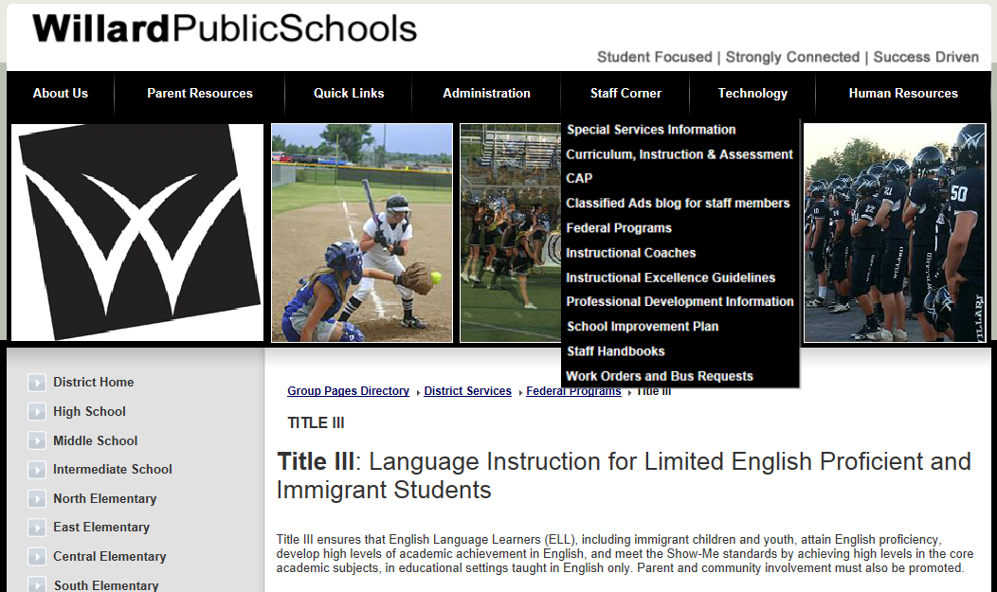
websites
Federal Programs
Title III Website
Willard ESL Website
willardesl.weebly.com
Notes:
We have a couple of websites that contain useful information about our ESL program. One is the Title 3 website, located under Federal Programs in the Staff Corner drop down menu on Willard’s district page. The other is our Willard ESL website for students, teachers, and parents. There is a link to it on every building’s website, or you can access it at willardesl.weebly.com. We try to send out blog posts regularly to staff about current events in our program or teaching strategies.

Slide 18
Contacting us
Email
Mailboxes or classrooms at each school
Google drive
Keep us informed as we try to do the same
Notes:
Contacting us is a little more difficult since we’re not in your building all the time. Email is usually the best option, as we try to check it regularly throughout the day. If it’s not an immediate concern, you can leave things in our mailboxes at each school, and we will check those when we’re there. Keep us informed, and we will try to do the same with you. Let us know what we can focus on during our time with ESL students, or let us know about concerns or questions you have as you work with them. We hope that the folder we gave you at the beginning of the year will be helpful to you, but we don’t want that to be the only conversation we have about your ESL student(s). Each year, we are learning more about how to meet our goals and work collaboratively with classroom teachers, but we are not there yet. Let us know how we can help you.

